Slide 1


Exploring experimental conditions to reduce uncertainties in the optical model
Manuel Catacora-Rios
Michigan State University
In collaboration with: G. B. King , A. E. Lovell and F. M. Nunes
M. Catacora-Rios, G. B. King, A. E. Lovell and F. M. Nunes Reaction Seminar: April 23rd 2020 1/24

Slide 2
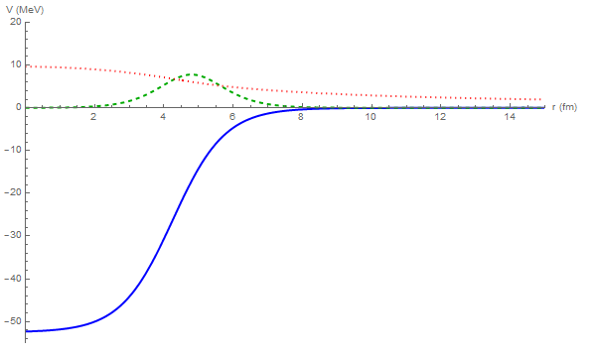
Few-body reaction models and Optical Potentials
V_{C}
Few-body methods for reactions require as input nucleon-nucleus optical potentials: interactions that effectively describe the many-body scattering problem
W_{S}
U (MeV)
r (fm)
V
I.J. Thompson and F.M. Nunes, Nuclear Reactions for Astrophysics, (Cambridge University Press, Cambridge, 2009)
M. Catacora-Rios, G. B. King, A. E. Lovell and F. M. Nunes Reaction Seminar: April 23rd 2020 2/24

Slide 3
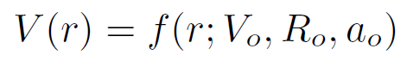
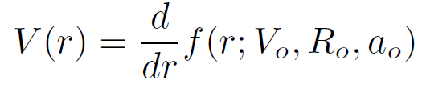
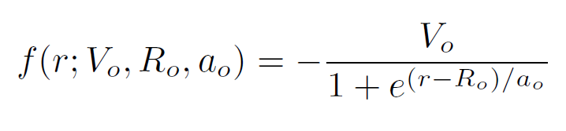

Fitting Optical Potentials
V_{C}
U (MeV)
W_{S}
r (fm)
Volume Term
V
Surface and Spin-Orbit Terms
Typically we consider 9 parameters:
Real Volume (V, r, a).
Imaginary Volume (W, rw, aw)
Imaginary Surface (Ws, rs, as)
Keep the spin orbit and Coulomb interactions constant.
I.J. Thompson and F.M. Nunes, Nuclear Reactions for Astrophysics, (Cambridge University Press, Cambridge, 2009)
M. Catacora-Rios, G. B. King, A. E. Lovell and F. M. Nunes Phys. Rev. C 100, 06461 Reaction Seminar: April 19th 2020 5/16
M. Catacora-Rios, G. B. King, A. E. Lovell and F. M. Nunes Reaction Seminar: April 23rd 2020 3/24

Slide 4
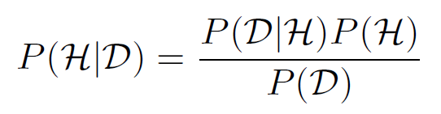
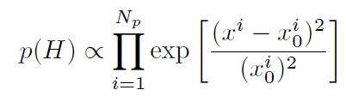
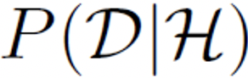
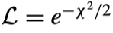
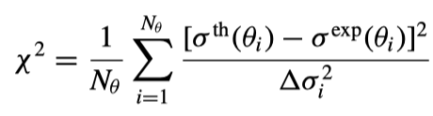
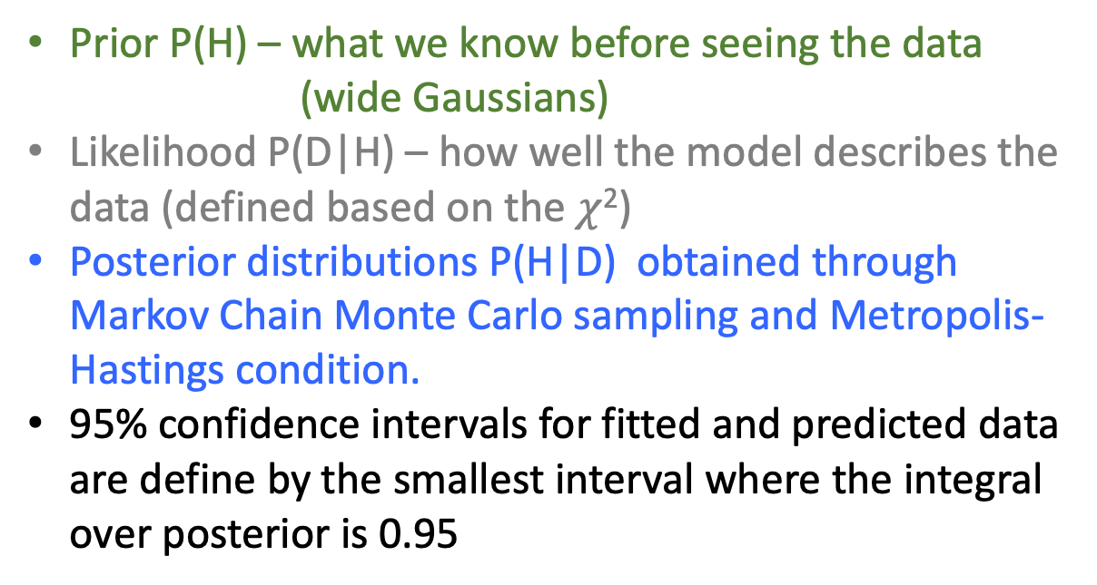
Bayesian Theory (remember introduction by Amy Lovell)
Likelihood
Prior
Prior P(H) – what we know before seeing the data
(wide Gaussians)
Likelihood P(D|H) – how well the model describes the data (defined based on the $χ$²)
Posterior distributions P(H|D) obtained through Markov Chain Monte Carlo sampling and Metropolis-Hastings condition.
95% confidence intervals for fitted and predicted data are define by the smallest interval where the integral over posterior is 0.95
Posterior
Evidence
Built on top of I. Thompson’s fresco: www.fresco.org.uk
M. Catacora-Rios, G. B. King, A. E. Lovell and F. M. Nunes Reaction Seminar: April 23rd 2020 4/24

Slide 5
Parametric Uncertainties in the Optical Potential
²⁰⁸Pb(p,p) at 61 MeV
Uncertainties from the optical potentials are larger than previously thought (can be as large as 100%!)
Need to explore ways to reduce optical potential uncertainties
Here we explore:
Angular coverage
Nearby beam energies
Experimental error
Including the total reaction cross section
M. Catacora-Rios, G. B. King, A. E. Lovell and F. M. Nunes Reaction Seminar: April 23rd 2020 5/24

Slide 6

Mock Data
Generating mock data from a global optical potential is useful because we:
Can manipulate the experimental conditions
Not restricted to the availability of experimental data
Eliminates model uncertainties
The data includes angles from 5-160 . The data selected to have between 6-12 data points per peak. 10% experimental error is assigned.
Mock data was generated using Koning-Delaroche global parametrization (KD): A. J. Koning and J. P. Delaroche, Nucl. Phys. A 713, 231 (2003)
⁴⁸Ca(p,p) @12 MeV
²⁰⁸Pb(n,n) @ 30 MeV
Reactions | Main Energy | Nearby Energy
⁴⁸Ca(p,p) | 12 MeV | 14 MeV
⁴⁸Ca(n,n) | 12 MeV | 14 MeV
⁴⁸Ca(p,p) | 21 MeV | 24 MeV
²⁰⁸Pb(p,p) | 30 MeV | 32 MeV
²⁰⁸Pb(n,n) | 30 MeV | 32 MeV
²⁰⁸Pb(p,p) | 61 MeV | 65 MeV
$$°$$
M. Catacora-Rios, G. B. King, A. E. Lovell and F. M. Nunes Phys. Rev. C 100, 06461 Reaction Seminar: April 19th 2020 6/16
M. Catacora-Rios, G. B. King, A. E. Lovell and F. M. Nunes Reaction Seminar: April 23rd 2020 6/24

Slide 7
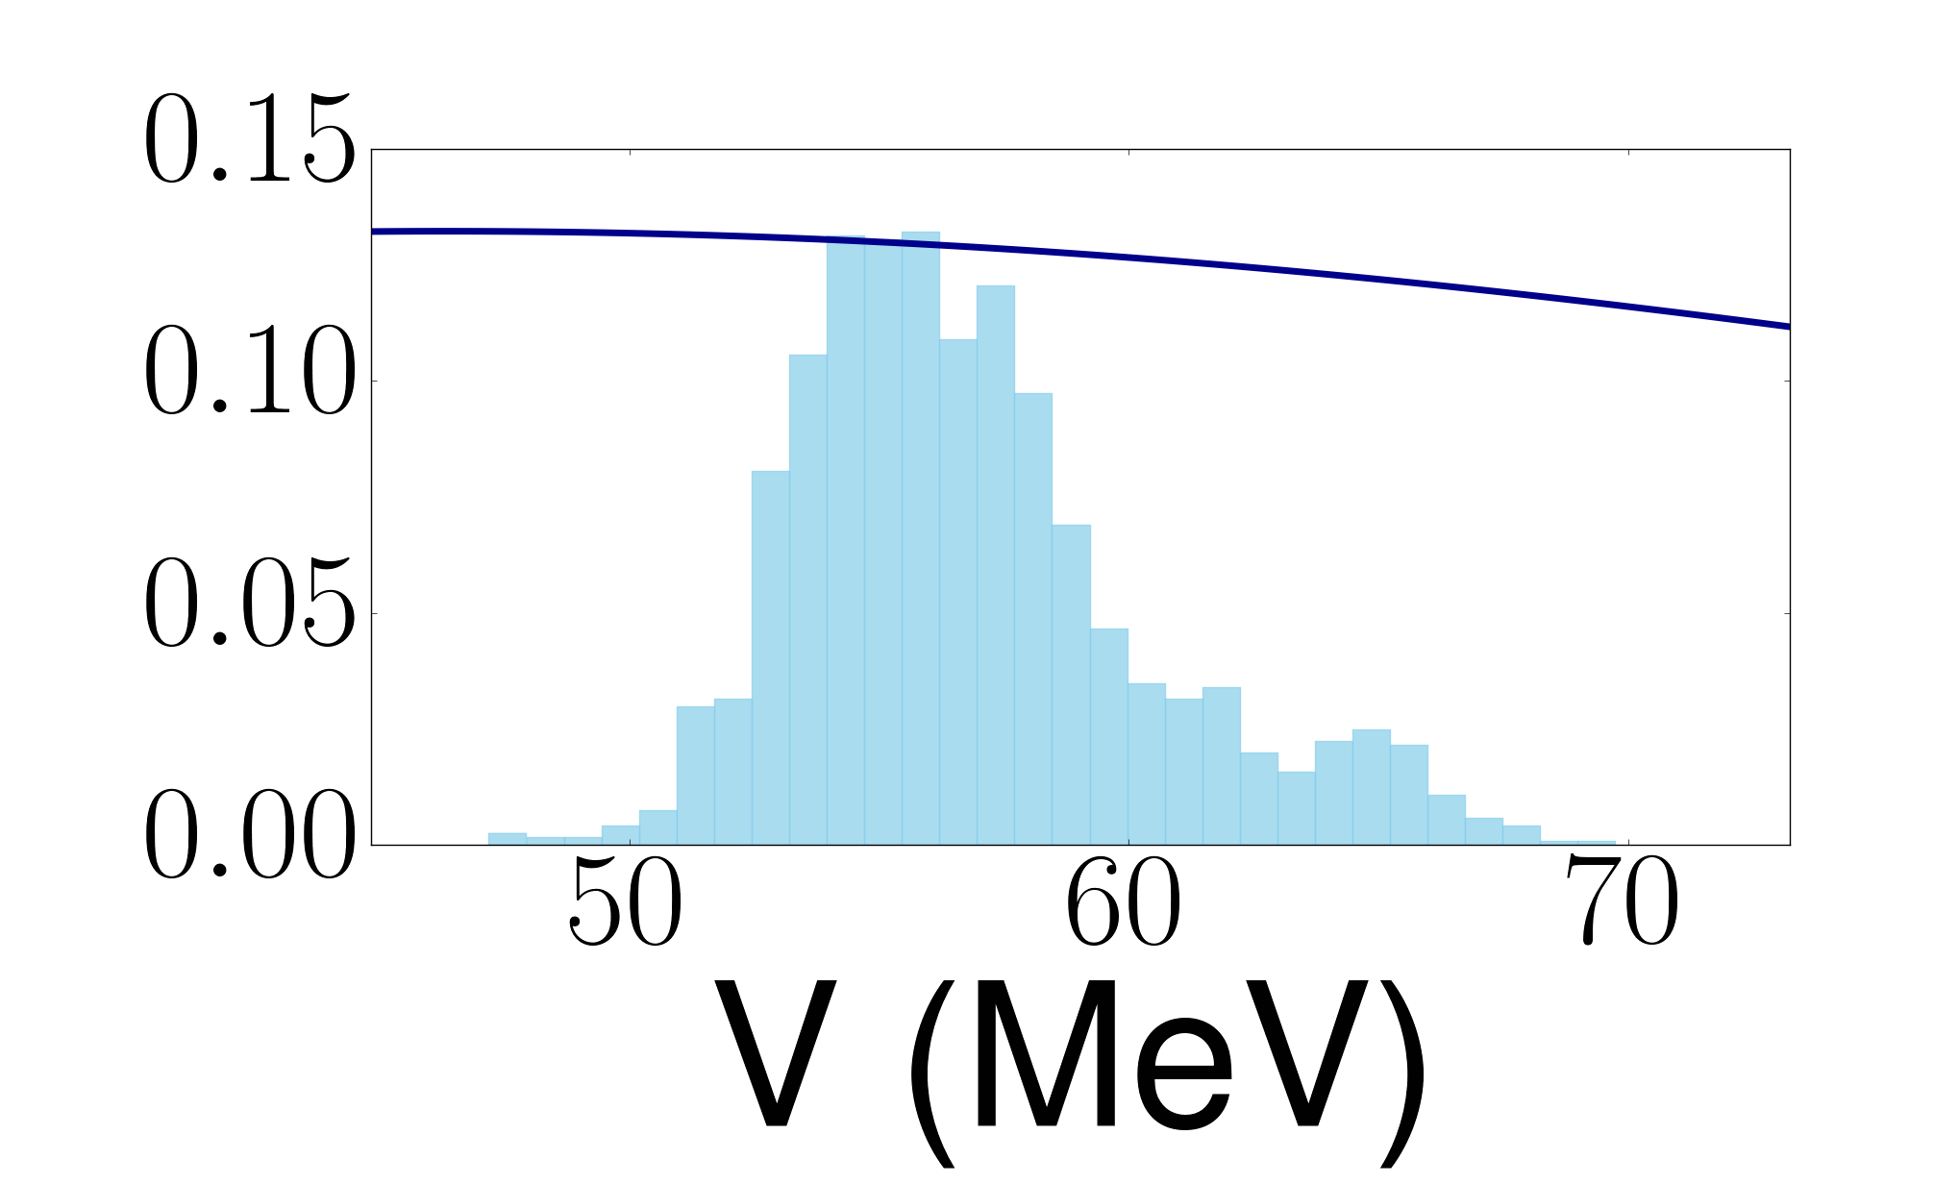
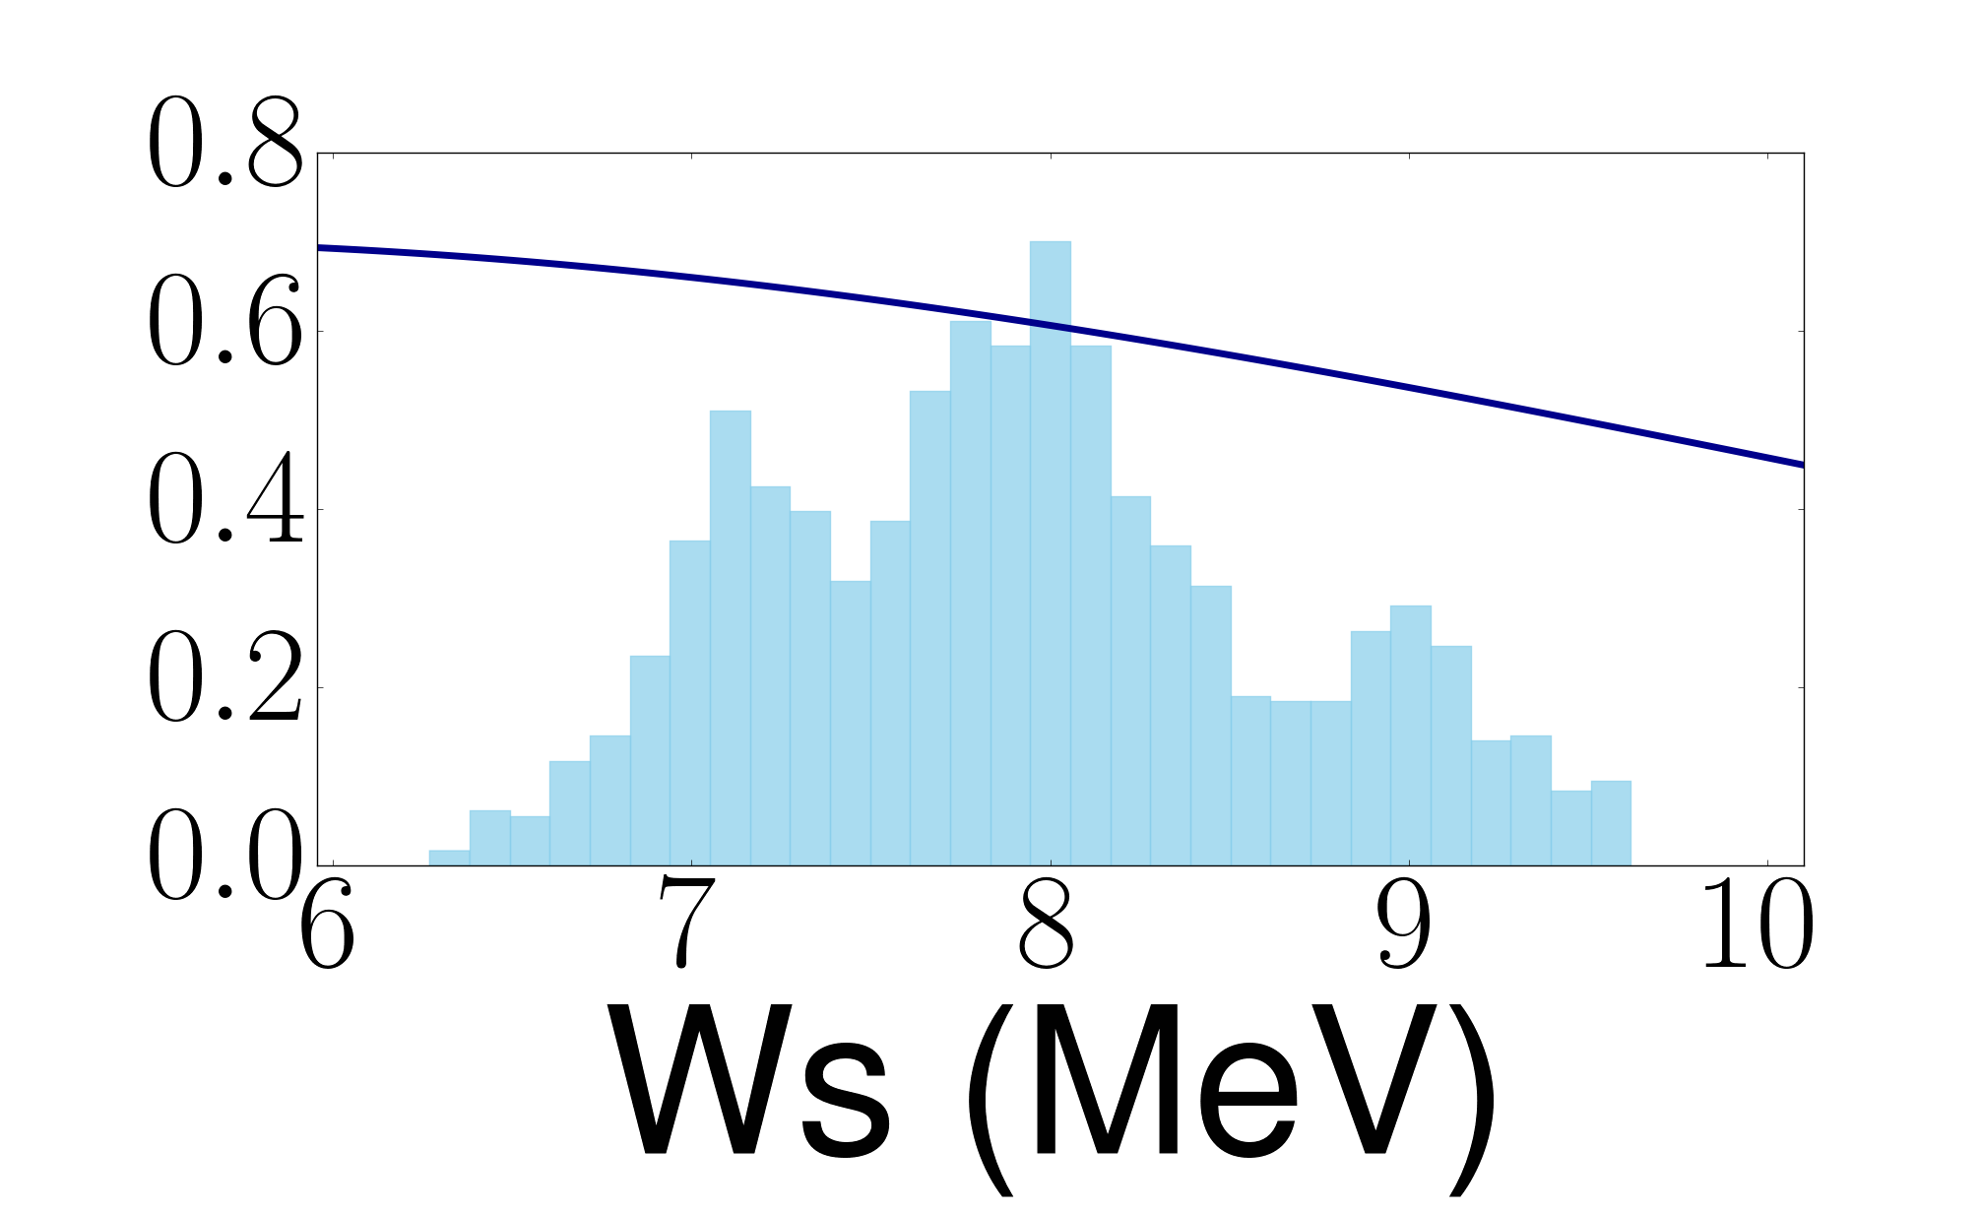
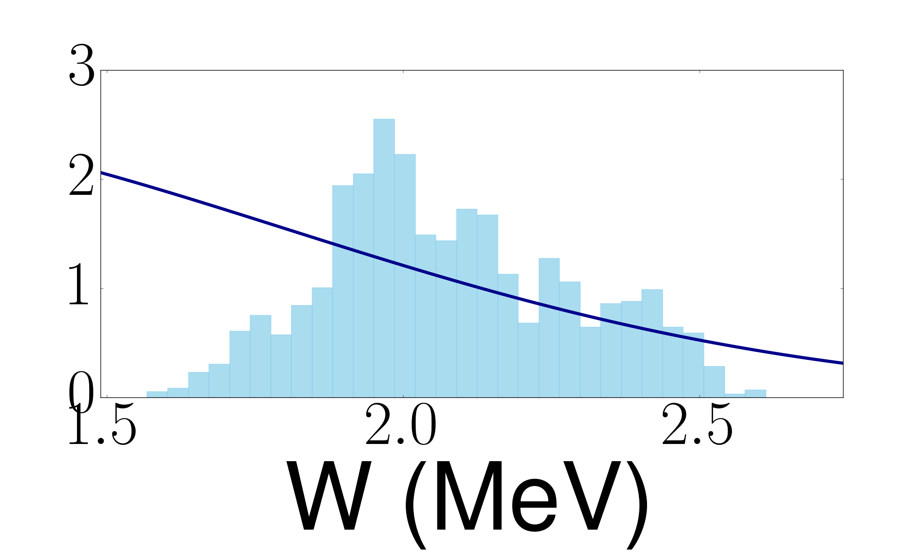
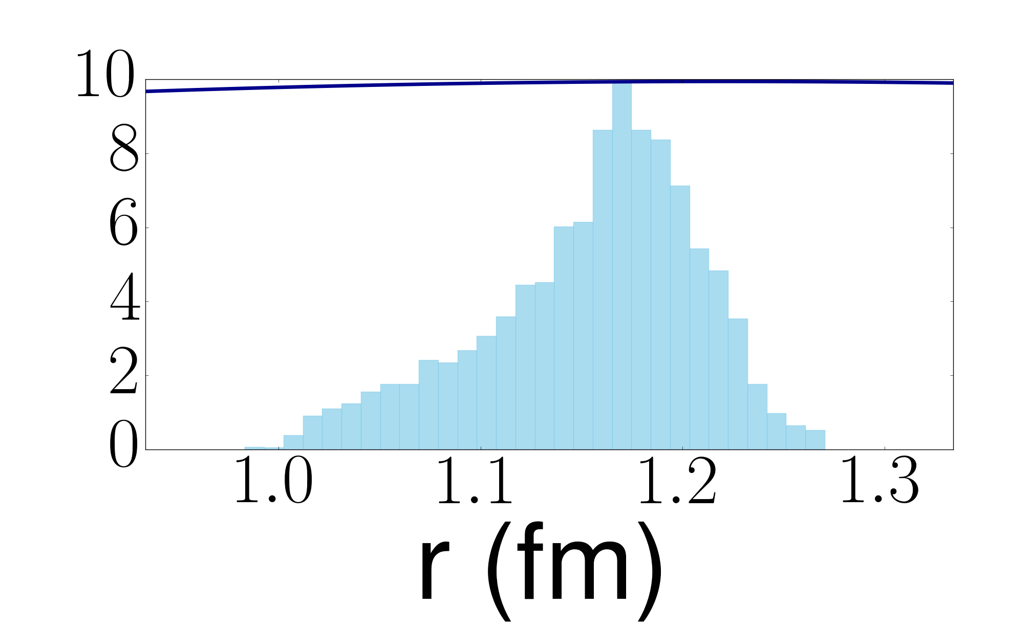
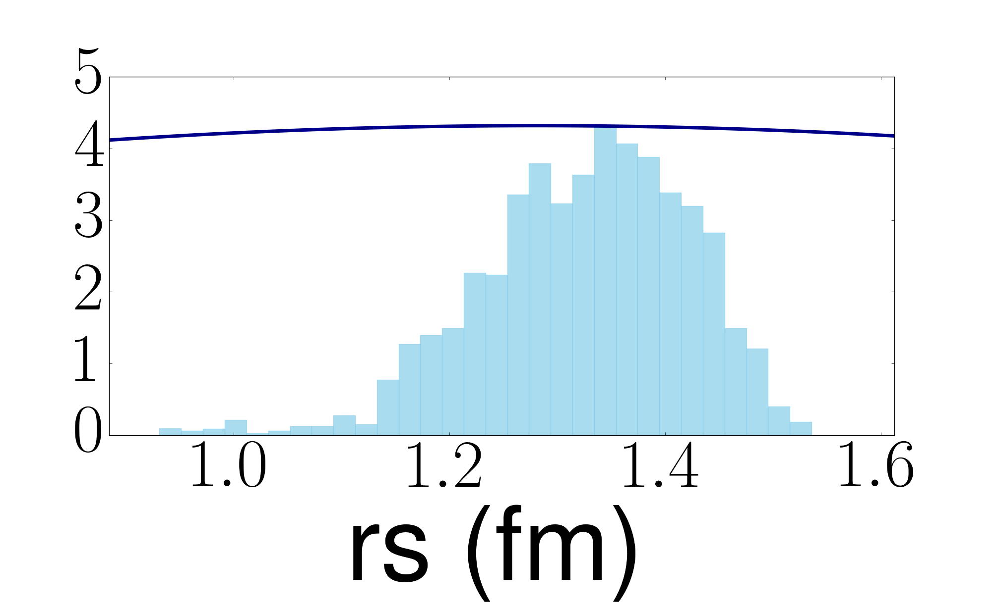
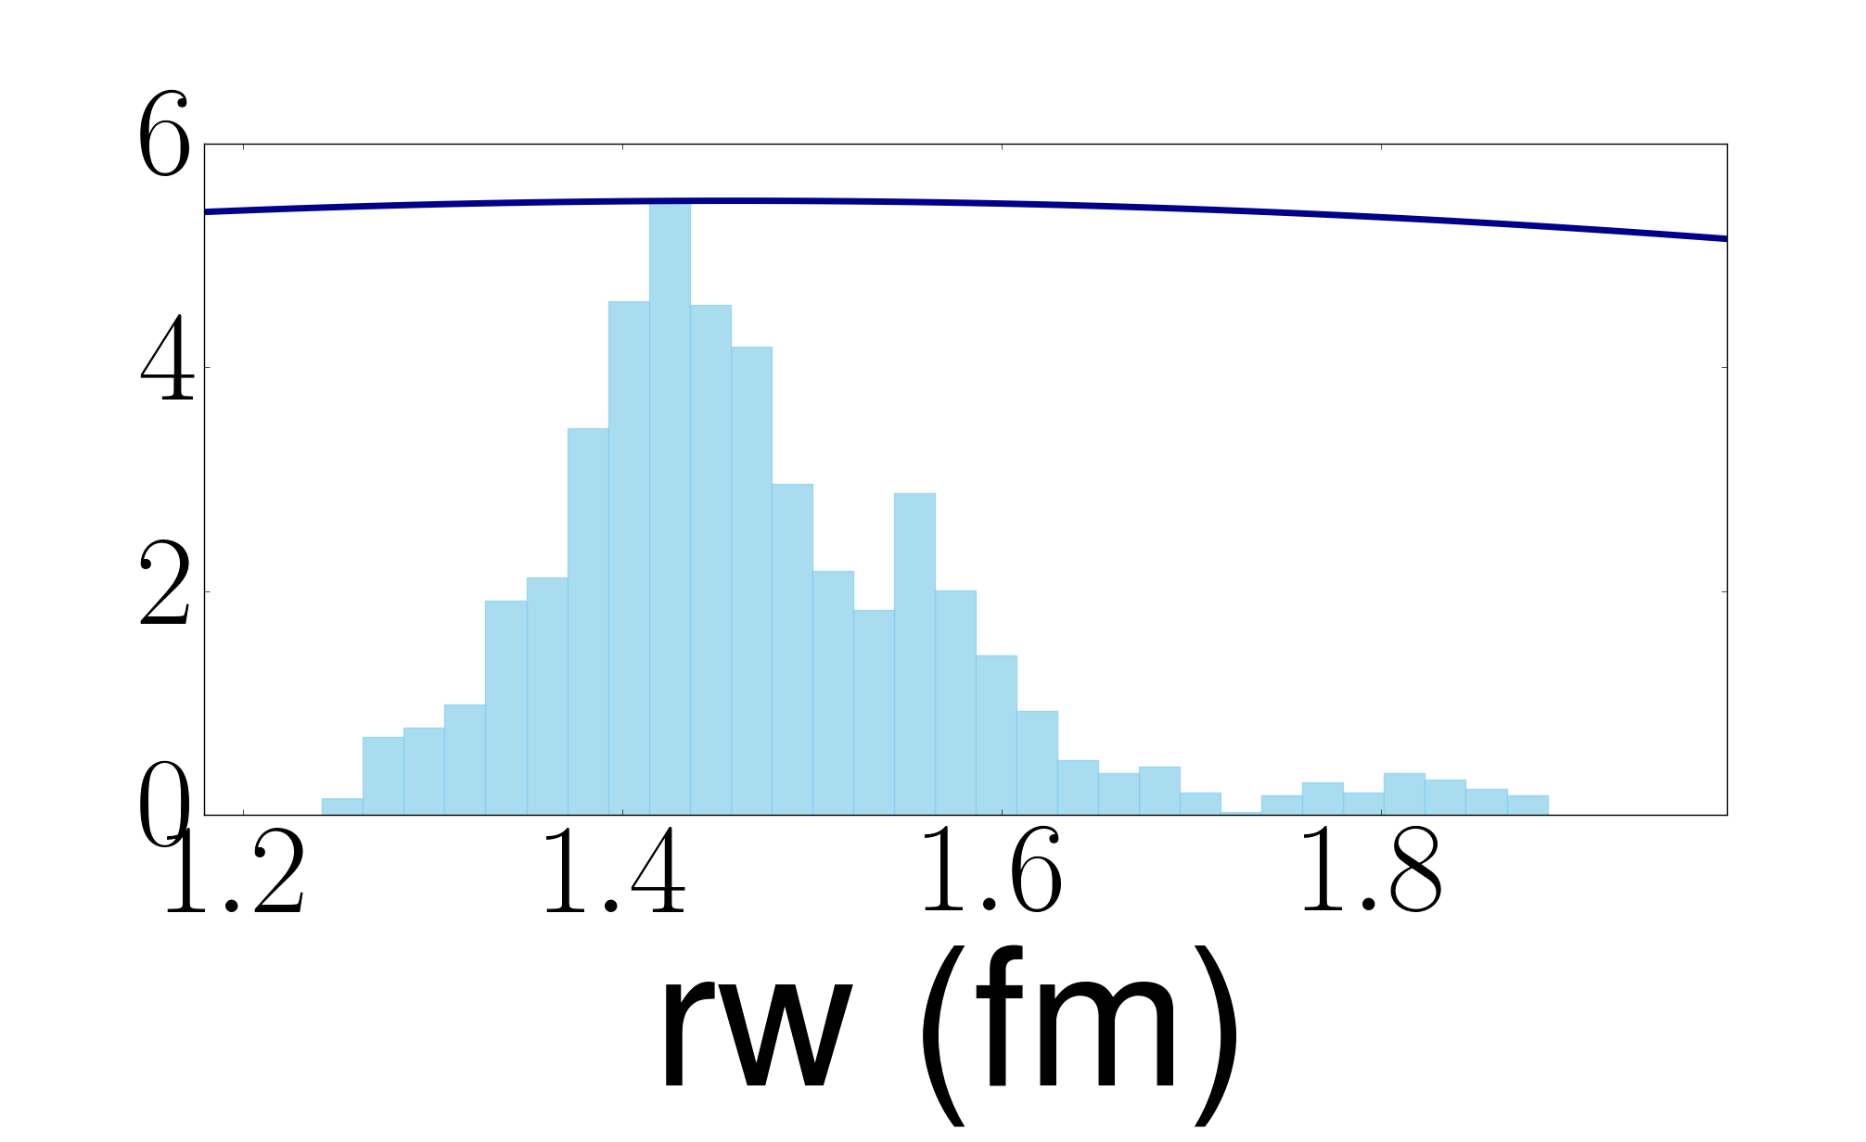
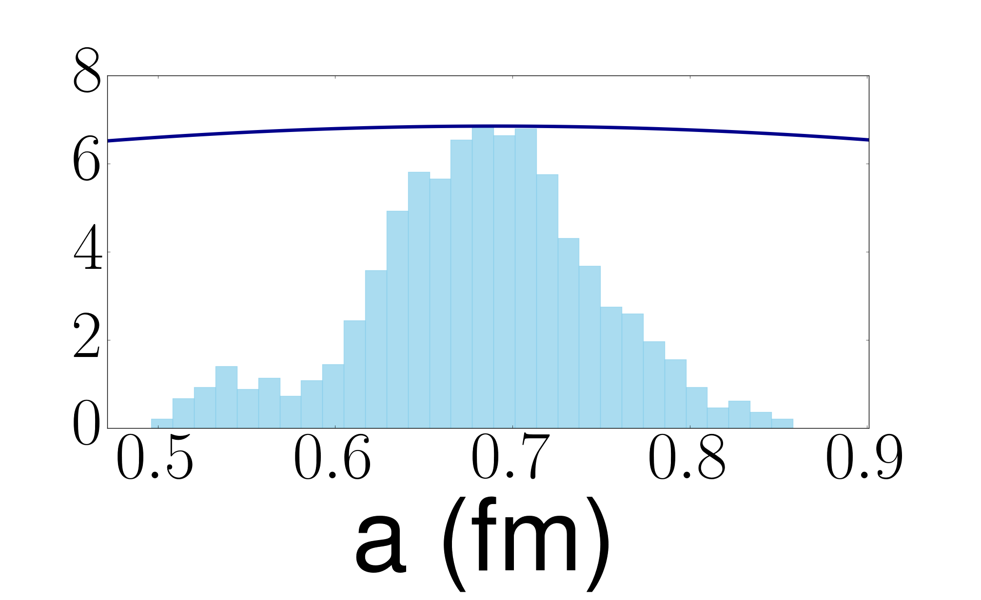
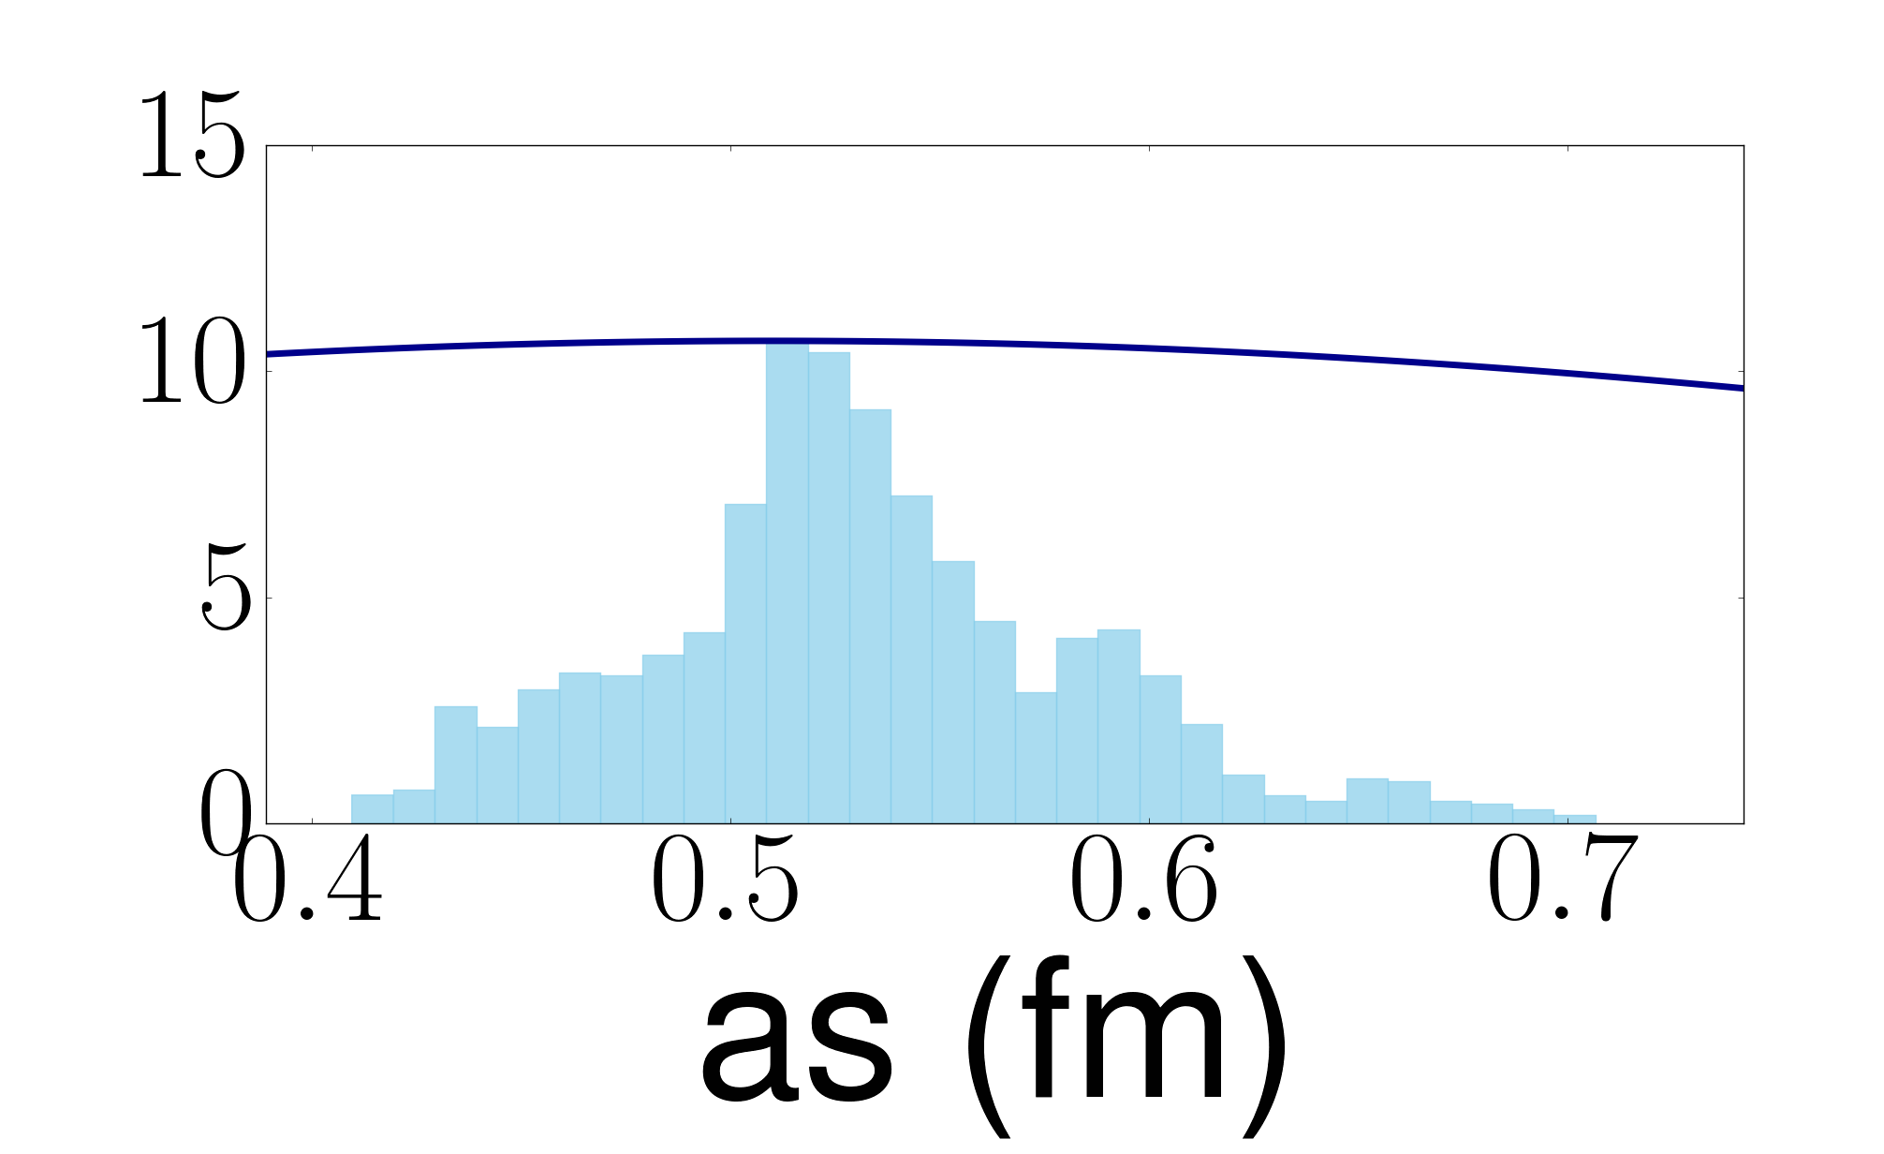
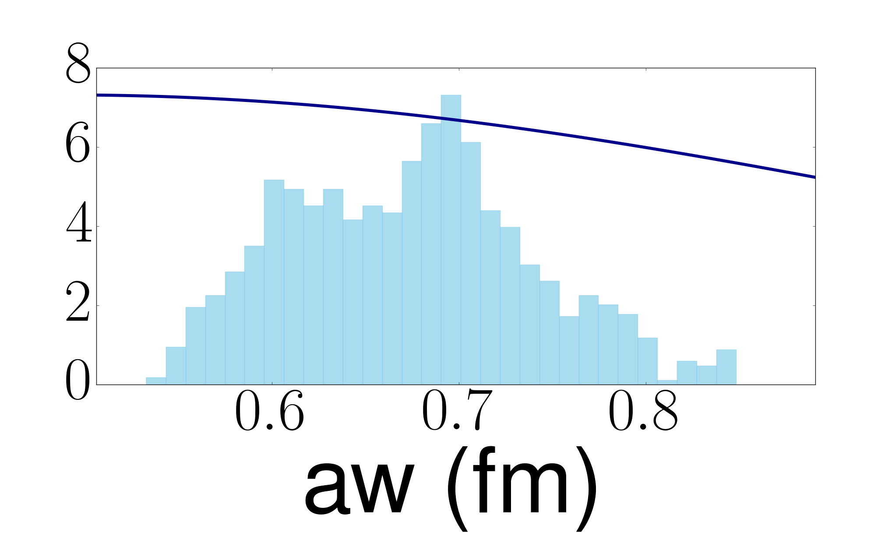
Bayesian Numerical Details
Bayesian fitting of the optical potentials includes 9-parameters.
Use a wide gaussian prior with a width of 100% around the Becchetti and Greenlees global parametrization (BG).
Fit the mock data generated from KD.
Pull 1600 parameter sets with the Markov Chain Monte Carlo sampling.
⁴⁸Ca(p,p) @ 21 MeV. Posterior distributions of optical parameters.
Built on top of I. Thompson’s fresco: www.fresco.org.uk
F. D. Becchetti, Jr. and G. Greenlees, Phys. Rev. 182, 1190 (1969)
M. Catacora-Rios, G. B. King, A. E. Lovell and F. M. Nunes Phys. Rev. C 100, 064615 Reaction Seminar: April 19th 2020 4/16
M. Catacora-Rios, G. B. King, A. E. Lovell and F. M. Nunes Reaction Seminar: April 23rd 2020 7/24

Slide 8
Propagation to single-nucleon (d,p) transfer
Use reaction model ADWA discussed by Lovell that includes deuteron breakup.
Input the optical potential interactions from Bayesian fitting of nucleon elastic scattering
Our elastic scattering energies match the incoming and outgoing channels.
Incoming channel
Outgoing channel
d(n+p) + A
B(A+n) + p
²⁰⁸Pb(n,n) at 30 MeV
²⁰⁸Pb(p,p) at 30 MeV
²⁰⁸Pb(p,p) at 61 MeV
²⁰⁸Pb(d,p) at 61 MeV
M. Catacora-Rios, G. B. King, A. E. Lovell and F. M. Nunes Phys. Rev. C 100, 064615 Reaction Seminar: April 19th 2020 7/16
M. Catacora-Rios, G. B. King, A. E. Lovell and F. M. Nunes Reaction Seminar: April 23rd 2020 8/24

Slide 9
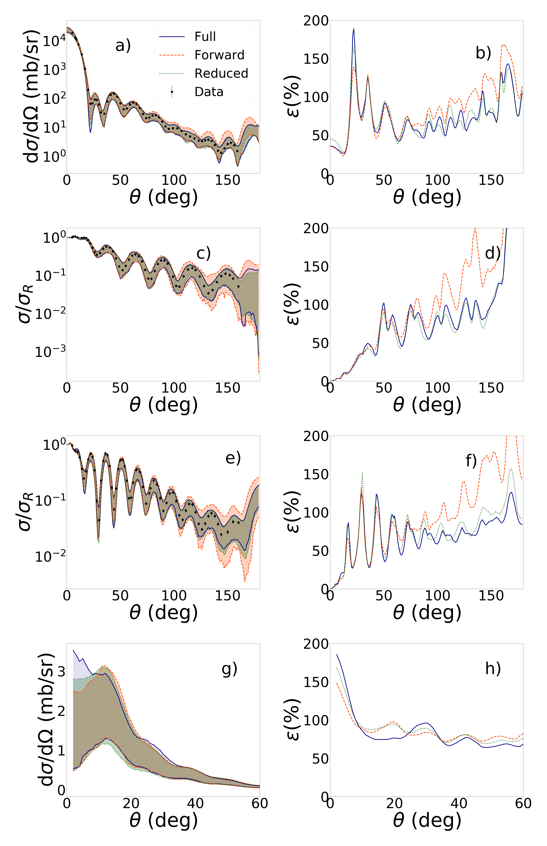
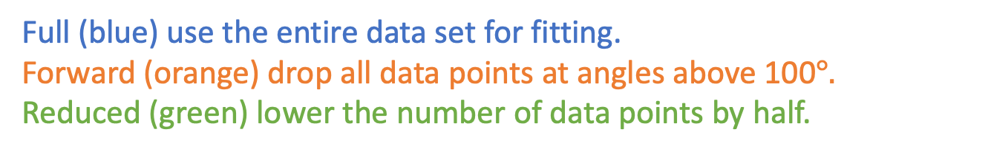
Results: Angular Thinning
Full (blue) use the entire data set for fitting.
Forward (orange) drop all data points at angles above 100$°.$
Reduced (green) lower the number of data points by half.
²⁰⁸Pb(n,n) @ 30 MeV
²⁰⁸Pb(n,n) at 30 MeV
M. Catacora-Rios, G. B. King, A. E. Lovell, and F. M. Nunes Phys. Rev. C 100, 064615
M. Catacora-Rios, G. B. King, A. E. Lovell and F. M. Nunes Phys. Rev. C 100, 064615 Reaction Seminar: April 19th 2020 8/16
M. Catacora-Rios, G. B. King, A. E. Lovell and F. M. Nunes Reaction Seminar: April 23rd 2020 9/24

Slide 10
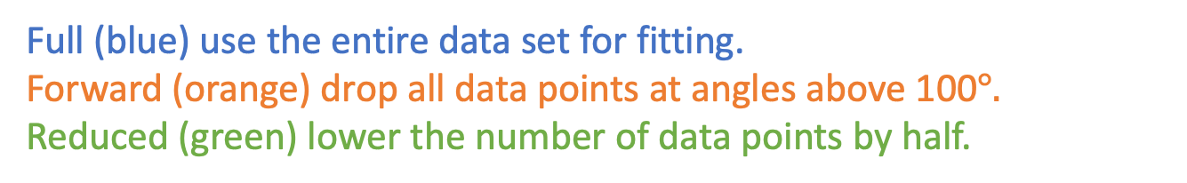
Results: Angular Thinning
²⁰⁸Pb(n,n) @ 30 MeV
Full (blue) use the entire data set for fitting.
Forward (orange) drop all data points at angles above 100$°.$
Reduced (green) lower the number of data points by half.
²⁰⁸Pb(n,n) at 30 MeV
²⁰⁸Pb(p,p) at 30 MeV
²⁰⁸Pb(p,p) at 61 MeV
²⁰⁸Pb(d,p) at 61 MeV
Same results for other cases
M. Catacora-Rios, G. B. King, A. E. Lovell and F. M. Nunes Phys. Rev. C 100, 064615 Reaction Seminar: April 19th 2020 8/16
M. Catacora-Rios, G. B. King, A. E. Lovell and F. M. Nunes Reaction Seminar: April 23rd 2020 10/24

Slide 11
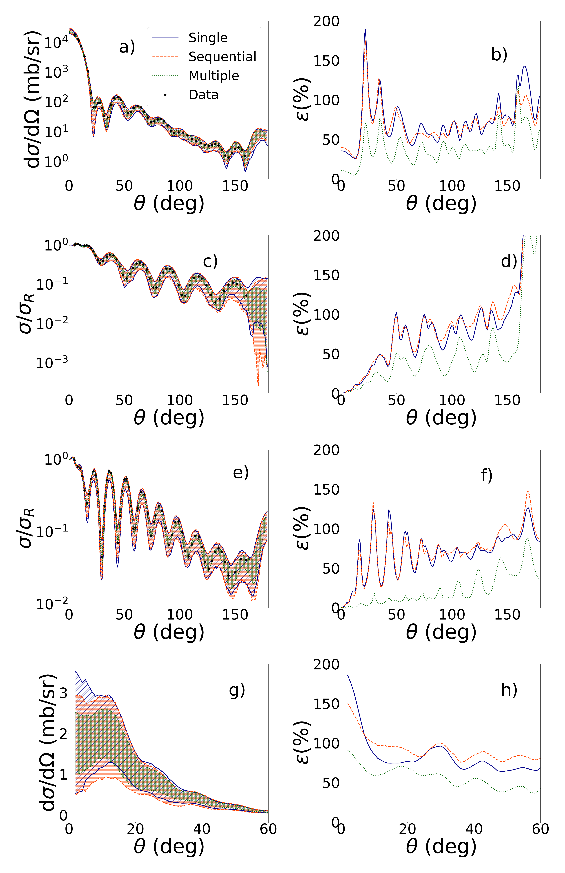
Results: Multiple Data Sets I
Single (blue): one single data set used
Sequential (orange): use posteriors of first data set as prior for second
Simultaneously (green): fit the two data sets at the same time
²⁰⁸Pb(p,p) @ 61-65 MeV
²⁰⁸Pb(p,p) at 61 MeV
M. Catacora-Rios, G. B. King, A. E. Lovell, and F. M. Nunes Phys. Rev. C 100, 064615
M. Catacora-Rios, G. B. King, A. E. Lovell and F. M. Nunes Phys. Rev. C 100, 064615 Reaction Seminar: April 19th 2020 9/16
M. Catacora-Rios, G. B. King, A. E. Lovell and F. M. Nunes Reaction Seminar: April 23rd 2020 11/24

Slide 12
Results: Multiple Data Sets II
Single (blue): one single data set used
Sequential (orange): use posteriors of first data set as prior for second
Simultaneously (green): fit the two data sets at the same time
²⁰⁸Pb(n,n) at 30 MeV
²⁰⁸Pb(p,p) at 30 MeV
²⁰⁸Pb(p,p) at 61 MeV
²⁰⁸Pb(d,p) at 61 MeV
M. Catacora-Rios, G. B. King, A. E. Lovell, and F. M. Nunes Phys. Rev. C 100, 064615
M. Catacora-Rios, G. B. King, A. E. Lovell and F. M. Nunes Phys. Rev. C 100, 064615 Reaction Seminar: April 19th 2020 9/16
M. Catacora-Rios, G. B. King, A. E. Lovell and F. M. Nunes Reaction Seminar: April 23rd 2020 12/24

Slide 13
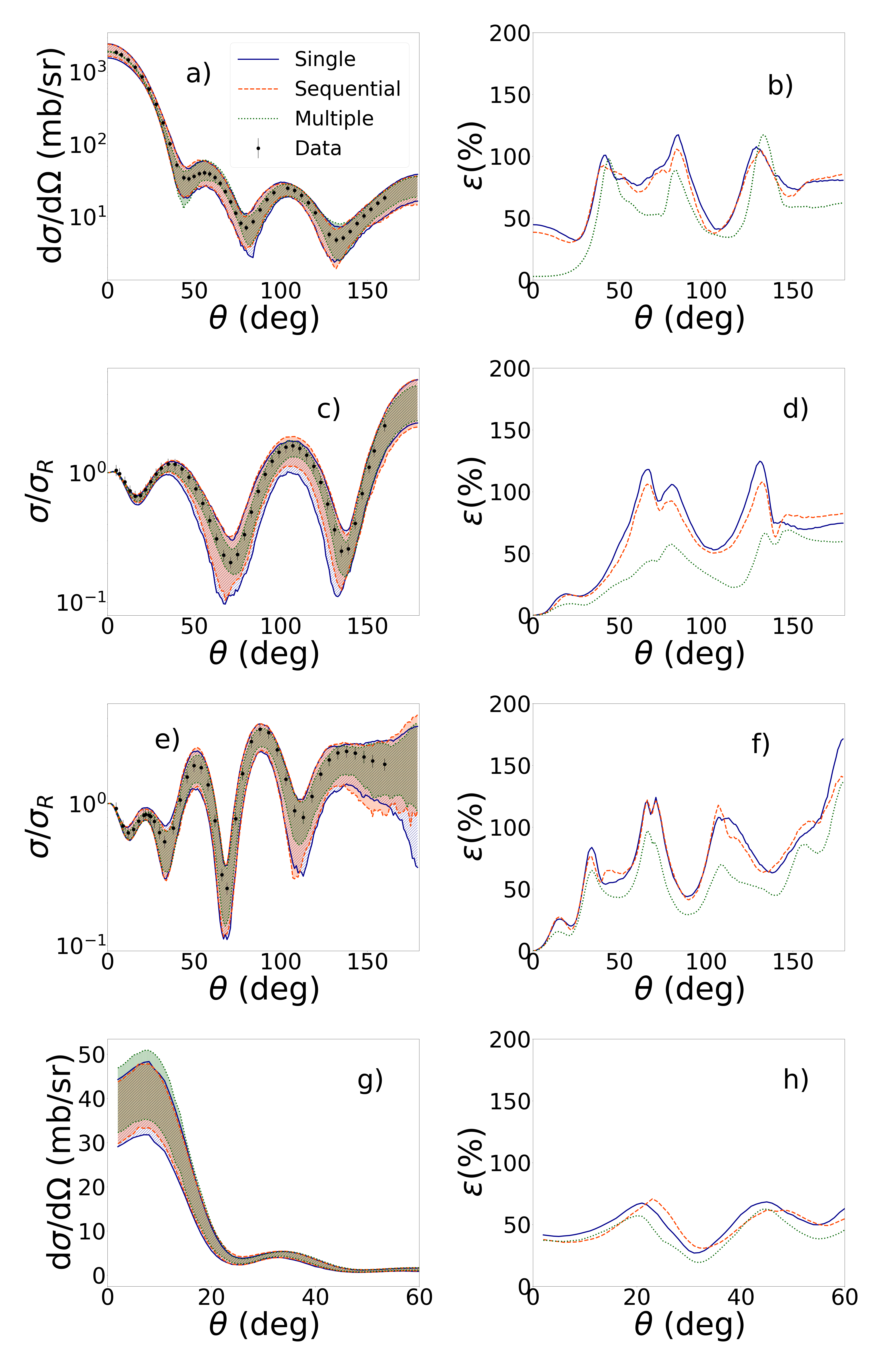
Results: Multiple Data Sets III
Our results show that:
Adding sequentially does not reduce the uncertainty.
Including data simultaneously in the fit significantly reduces the uncertainty for ²⁰⁸Pb (modest reduction for ⁴⁸Ca)
⁴⁸Ca(n,n) at 12 MeV
⁴⁸Ca(p,p) at 12 MeV
⁴⁸Ca(p,p) at 21 MeV
⁴⁸Ca(d,p) at 21 MeV
M. Catacora-Rios, G. B. King, A. E. Lovell, and F. M. Nunes Phys. Rev. C 100, 064615
M. Catacora-Rios, G. B. King, A. E. Lovell and F. M. Nunes Phys. Rev. C 100, 064615 Reaction Seminar: April 19th 2020 9/16
M. Catacora-Rios, G. B. King, A. E. Lovell and F. M. Nunes Reaction Seminar: April 23rd 2020 13/24

Slide 14
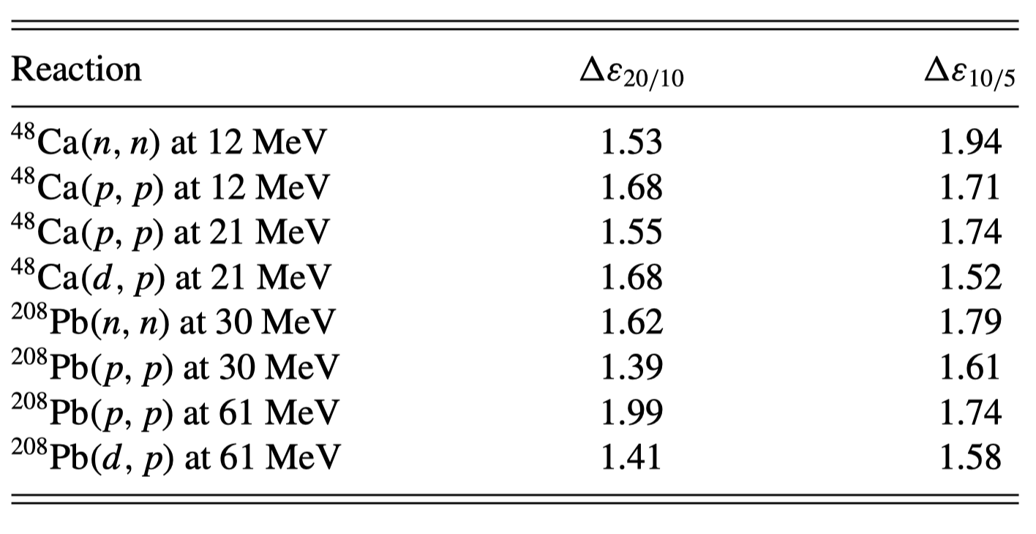
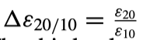
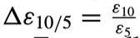
Results: Experimental Error Bar
Explore the effects of decreasing the experimental error on the percent error of angular distributions
The parametric uncertainty is reduced when we decrease the experimental error.
Decreasing experimental error by a factor of 2 does not decrease the uncertainty by that same factor.
Stressing the non-linearity of the problem.
²⁰⁸Pb(n,n) @ 30 MeV
M. Catacora-Rios, G. B. King, A. E. Lovell and F. M. Nunes Phys. Rev. C 100, 064615 Reaction Seminar: April 19th 2020 10/16
M. Catacora-Rios, G. B. King, A. E. Lovell and F. M. Nunes Reaction Seminar: April 23rd 2020 14/24

Slide 15
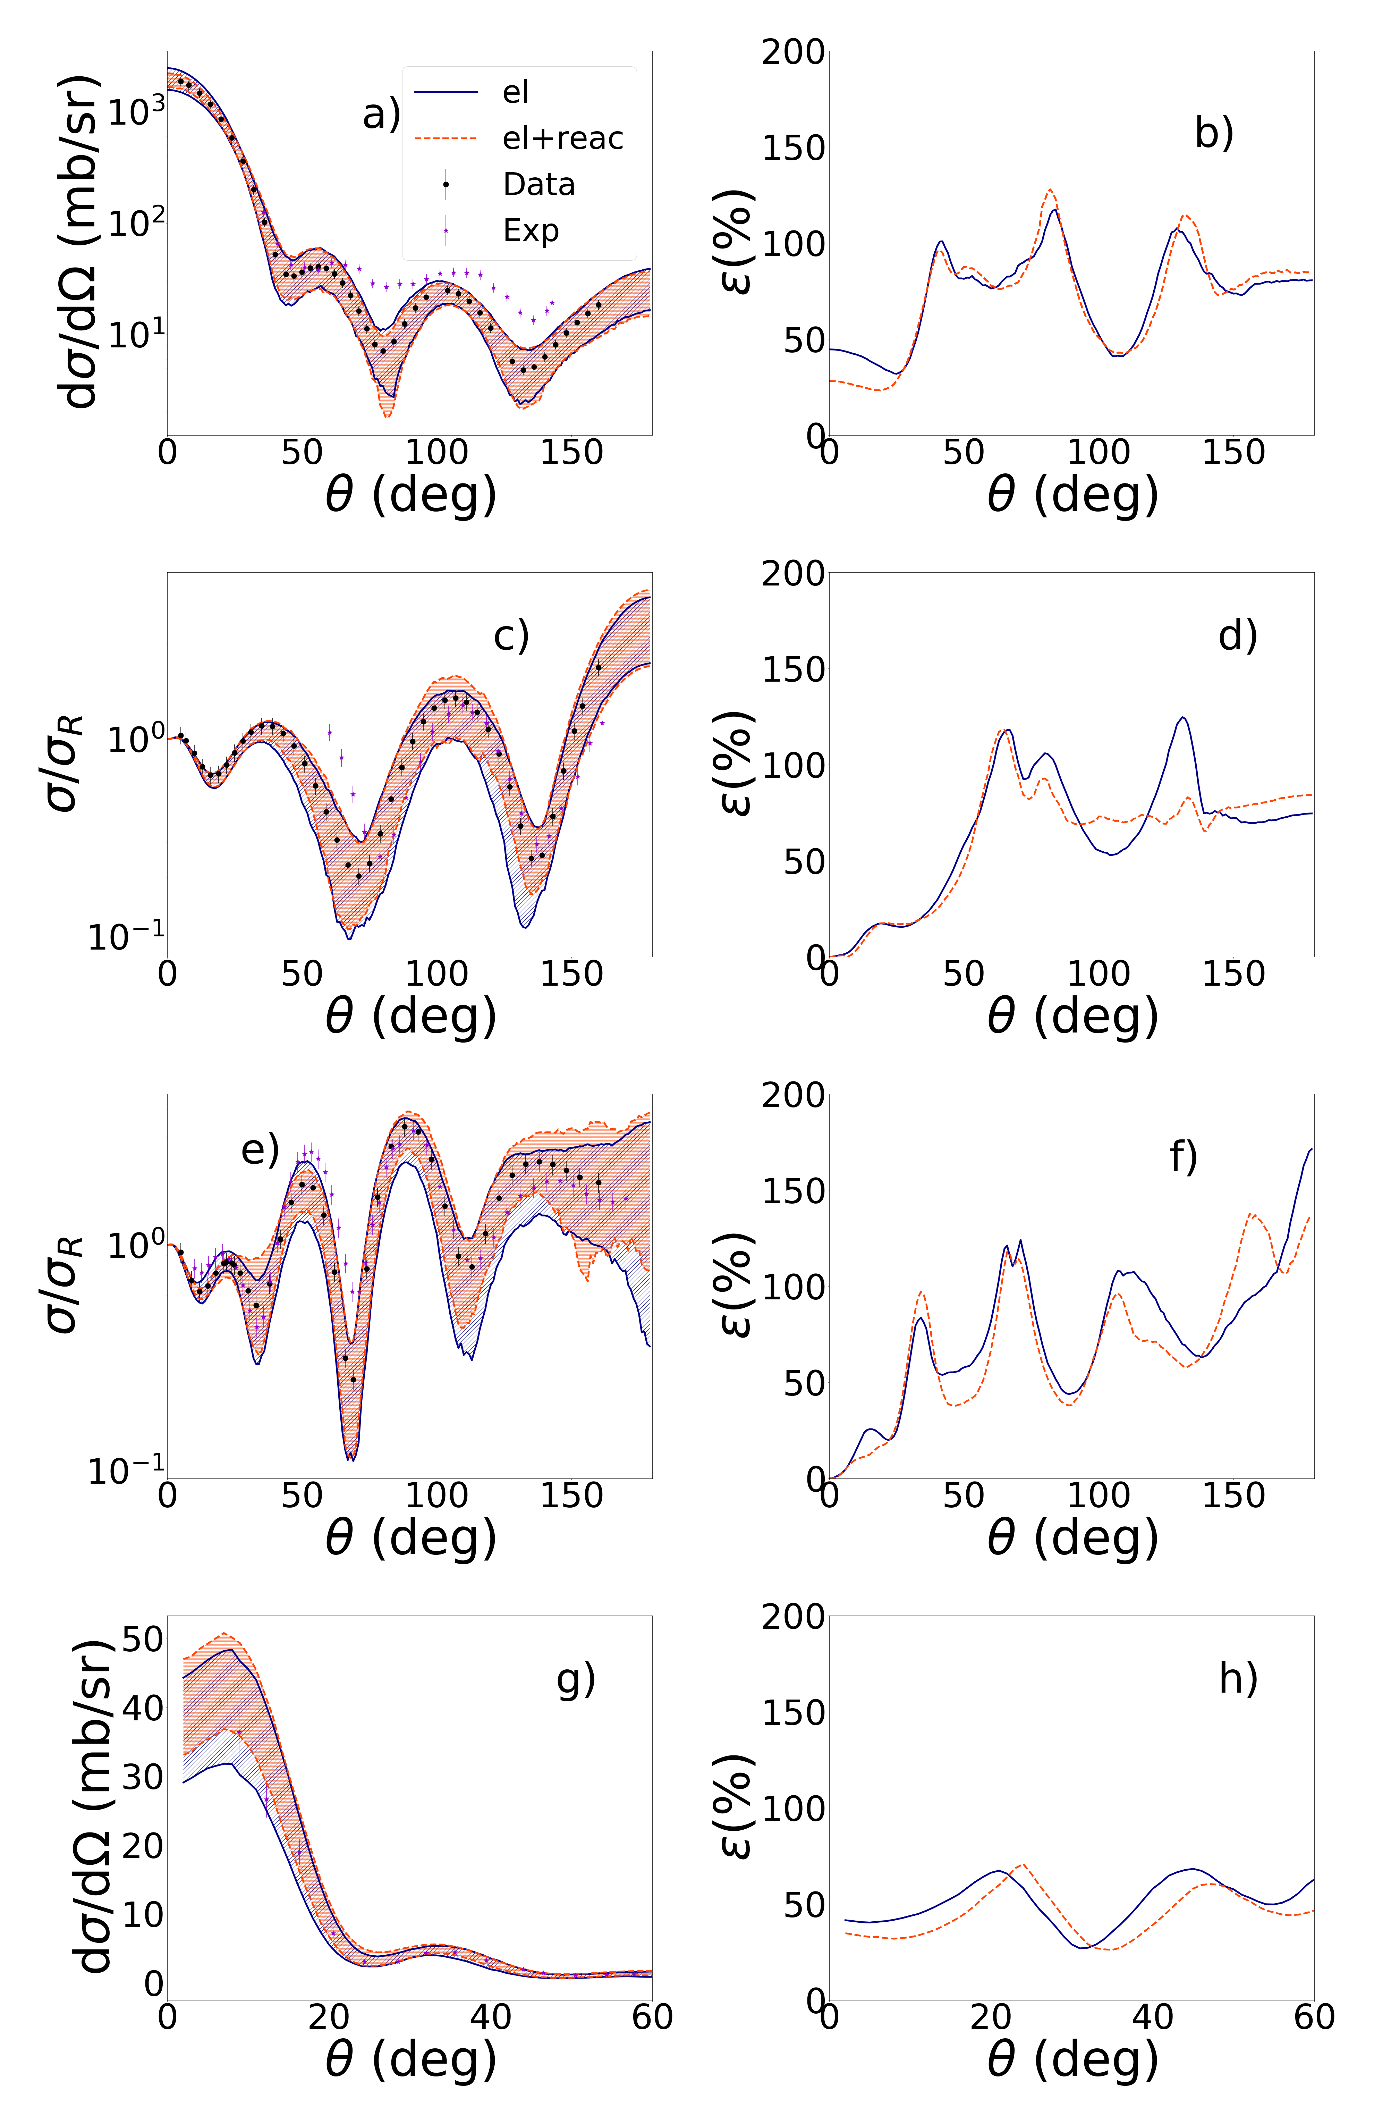
Results: Including the Reaction Cross Section I
“el” (blue) single data set elastic differential cross section.
“el+reac” (orange) elastic differential cross section and total reaction cross section.
⁴⁸Ca(p,p) at 21 MeV
M. Catacora-Rios, G. B. King, A. E. Lovell, and F. M. Nunes Phys. Rev. C 100, 064615
M. Catacora-Rios, G. B. King, A. E. Lovell and F. M. Nunes Phys. Rev. C 100, 064615 Reaction Seminar: April 19th 2020 11/16
M. Catacora-Rios, G. B. King, A. E. Lovell and F. M. Nunes Reaction Seminar: April 23rd 2020 15/24

Slide 16
Results: Including the Reaction Cross Section I
“el” (blue) single data set elastic differential cross section.
“el+reac” (orange) elastic differential cross section and total reaction cross section.
⁴⁸Ca(n,n) at 12 MeV
⁴⁸Ca(p,p) at 12 MeV
⁴⁸Ca(p,p) at 21 MeV
⁴⁸Ca(d,p) at 21 MeV
M. Catacora-Rios, G. B. King, A. E. Lovell, and F. M. Nunes Phys. Rev. C 100, 064615
M. Catacora-Rios, G. B. King, A. E. Lovell and F. M. Nunes Phys. Rev. C 100, 064615 Reaction Seminar: April 19th 2020 11/16
M. Catacora-Rios, G. B. King, A. E. Lovell and F. M. Nunes Reaction Seminar: April 23rd 2020 16/24

Slide 17
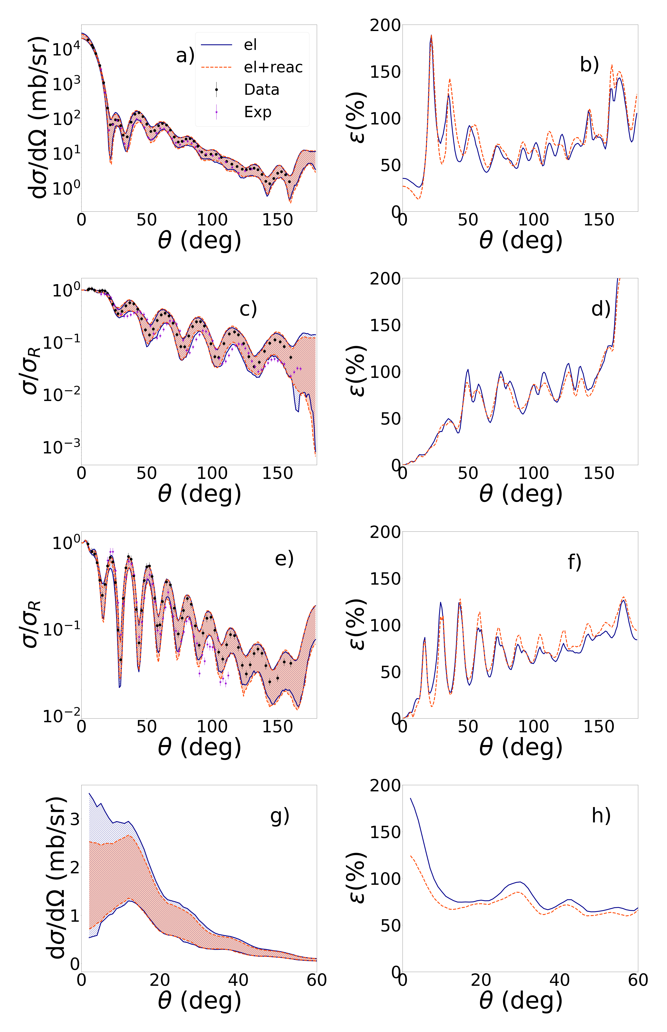
Results: Including the Reaction Cross Section II
Results
Adding the reaction cross section reduces uncertainty in some cases/angles.
²⁰⁸Pb(n,n) at 30 MeV
²⁰⁸Pb(p,p) at 30 MeV
²⁰⁸Pb(p,p) at 61 MeV
²⁰⁸Pb(d,p) at 61 MeV
M. Catacora-Rios, G. B. King, A. E. Lovell, and F. M. Nunes Phys. Rev. C 100, 064615
M. Catacora-Rios, G. B. King, A. E. Lovell and F. M. Nunes Phys. Rev. C 100, 064615 Reaction Seminar: April 19th 2020 11/16
M. Catacora-Rios, G. B. King, A. E. Lovell and F. M. Nunes Reaction Seminar: April 23rd 2020 17/24

Slide 18
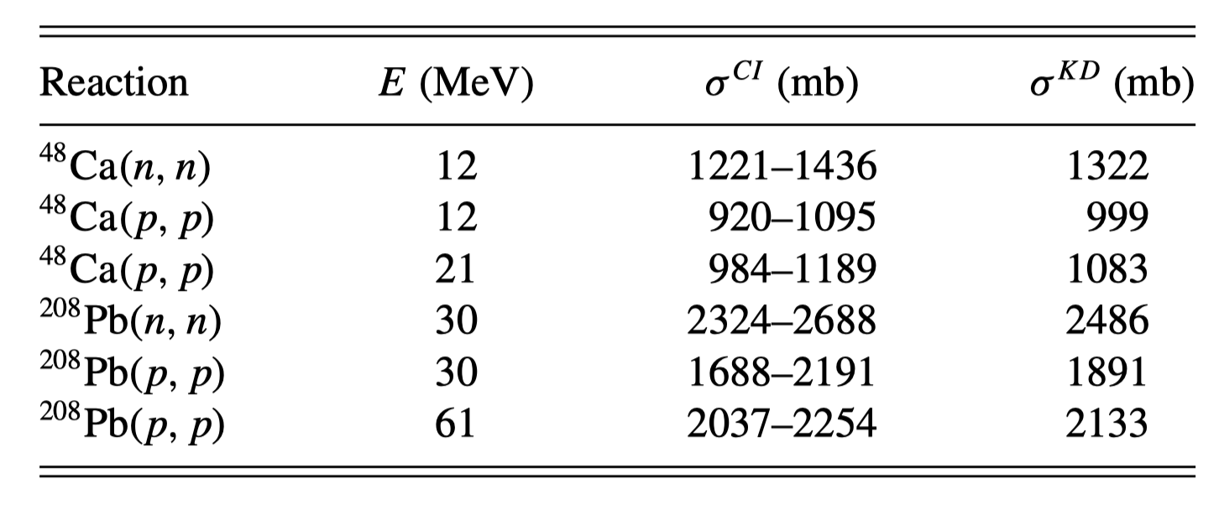
Results: Including the Reaction Cross Section III
Bayesian 95% confidence interval for the total reaction cross section.
M. Catacora-Rios, G. B. King, A. E. Lovell, and F. M. Nunes Phys. Rev. C 100, 064615
M. Catacora-Rios, G. B. King, A. E. Lovell and F. M. Nunes Phys. Rev. C 100, 064615 Reaction Seminar: April 19th 2020 12/16
M. Catacora-Rios, G. B. King, A. E. Lovell and F. M. Nunes Reaction Seminar: April 23rd 2020 18/24

Slide 19
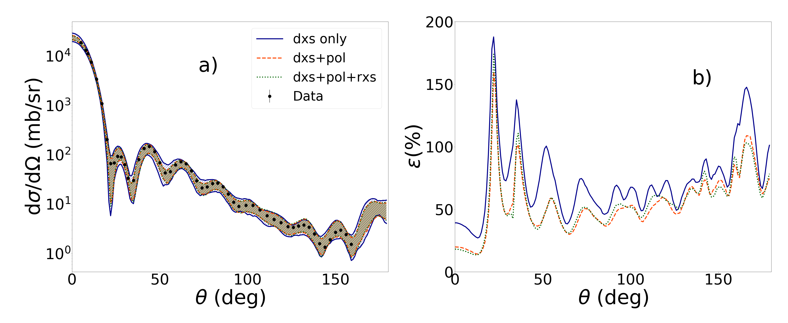
Polarization and other Observables I
“Dxs” (blue) single data set of differential cross section fitted.
“Dxs+pol” (orange) differential cross section data set and polarization data set fitted.
“Dxs+pol+rxs” (green) differential cross section data set, polarization data set and total cross section data fitted.
208Pb(n,n) at 30 MeV
M. Catacora-Rios, G. B. King, A. E. Lovell and F. M. Nunes Phys. Rev. C 100, 064615 Reaction Seminar: April 19th 2020 13/16
M. Catacora-Rios, G. B. King, A. E. Lovell and F. M. Nunes Reaction Seminar: April 23rd 2020 19/24

Slide 20
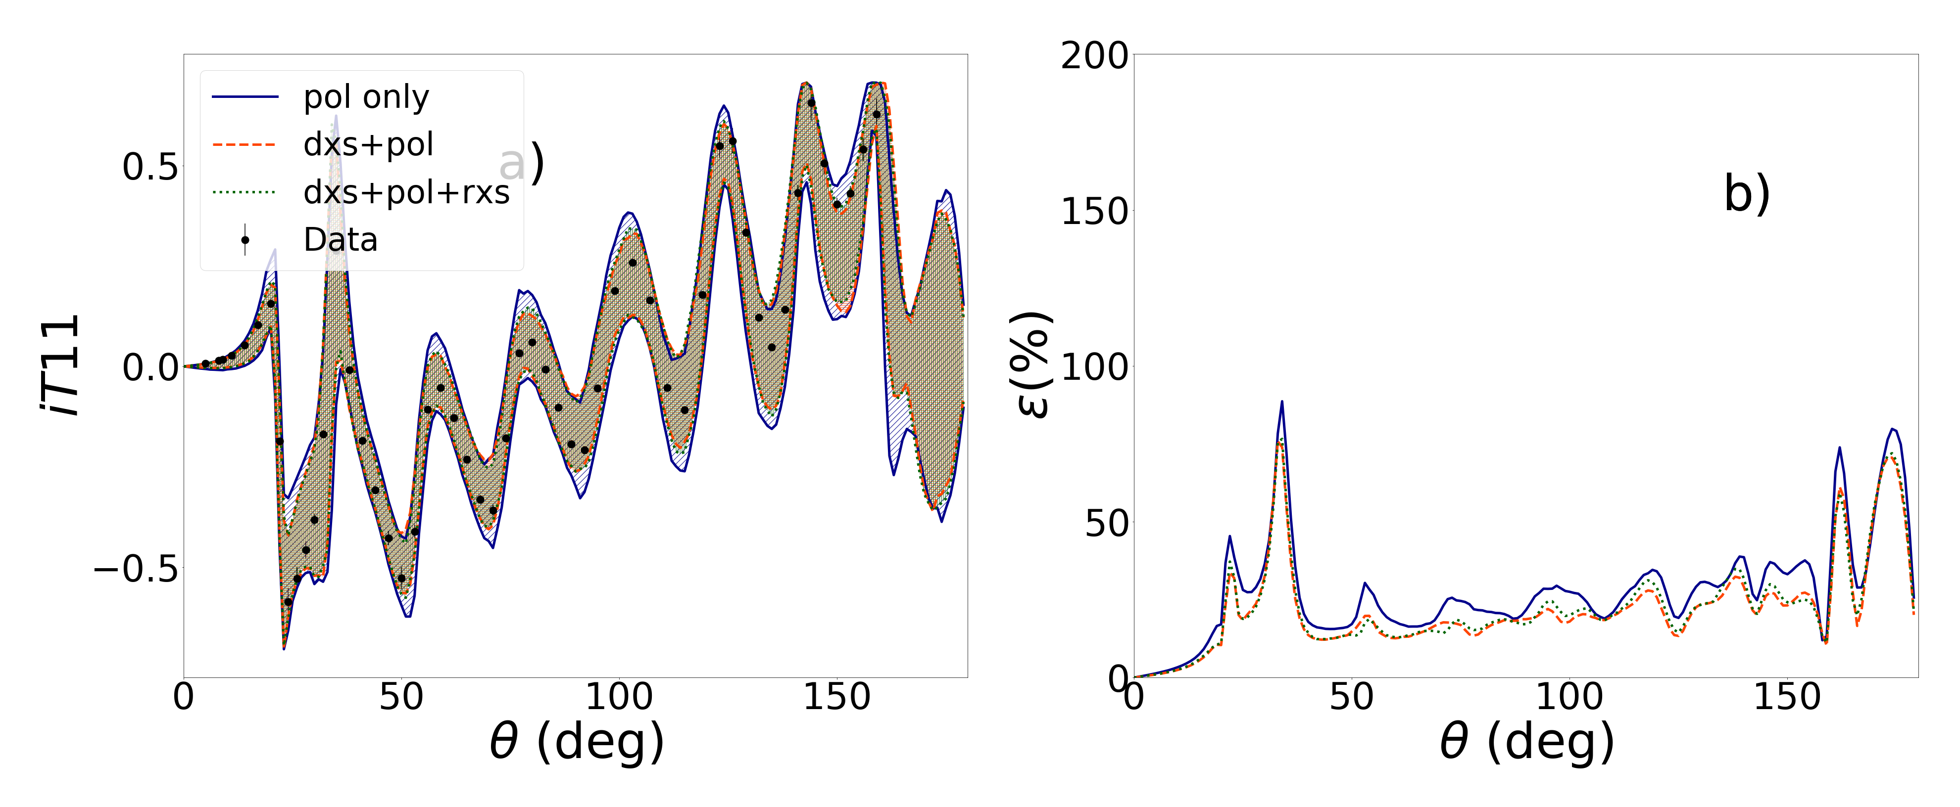
Polarization and other Observables II
“Pol” (blue) single data set of polarization fitted.
“Dxs+pol” (orange) differential cross section data set and polarization data set fitted.
“Dxs+pol+rxs” (green) differential cross section data set, polarization data set and total cross section data fitted.
Results:
Including the dxs, rxs and pol reduces the parametric uncertainty.
The main contribution comes from dxs and pol.
Elastic observables can only offer “so much” information.
208Pb(n,n) at 30 MeV
M. Catacora-Rios, G. B. King, A. E. Lovell and F. M. Nunes Phys. Rev. C 100, 064615 Reaction Seminar: April 19th 2020 13/16
M. Catacora-Rios, G. B. King, A. E. Lovell and F. M. Nunes Reaction Seminar: April 23rd 2020 20/24

Slide 21
Where does this work fit?
Planning
Experiment
Interpretation
UQ Reaction Efforts
My Work
M. Catacora-Rios, G. B. King, A. E. Lovell and F. M. Nunes Phys. Rev. C 100, 064615 Reaction Seminar: April 19th 2020 13/16
M. Catacora-Rios, G. B. King, A. E. Lovell and F. M. Nunes Reaction Seminar: April 23rd 2020 21/24

Slide 22
Outlook
Diversify the data to further reduce uncertainties
Charge exchange angular distributions
Other inelastic reactions
Model comparison, nested models, model error
How good is model A compared to model B?
What is the gain by including extra parameters in nested models?
Bayesian Evidence
Immediate Next Steps
Confronting results against real data.
Adding inelastic observables to the fit.
M. Catacora-Rios, G. B. King, A. E. Lovell and F. M. Nunes Phys. Rev. C 100, 064615 Reaction Seminar: April 19th 2020 13/16
M. Catacora-Rios, G. B. King, A. E. Lovell and F. M. Nunes Reaction Seminar: April 23rd 2020 22/24

Slide 23
Conclusions
We use Bayesian statistics to explore experimental conditions that can help reduce uncertainties. Our methods should be applicable to many energies and elements across the nuclear chart.
Once a diffraction pattern can be discerned, additional data points do not add new information as the angles are correlated. Keeping only the forward angles increases the uncertainty of the backward angles in all cases.
Adding a second data set at a nearby energy simultaneously in the fit can help reduce the uncertainty up to 50%. The nearby energy must be within 10% of the energy of interest. Adding a second data set at a nearby energy sequentially does not help reduce the parametric uncertainty.
Decreasing the experimental error bar does help decrease the parametric uncertainty, but the gain is not directly proportional and varies with each reaction.
A reduction of parametric uncertainty can be obtained by fitting simultaneously the differential cross section and the polarization. Adding the total reaction cross section does add a constraint, but the effect of smaller magnitude than the other two observables studied.
M. Catacora-Rios, G. B. King, A. E. Lovell and F. M. Nunes Phys. Rev. C 100, 064615 Reaction Seminar: April 19th 2020 14/16
M. Catacora-Rios, G. B. King, A. E. Lovell and F. M. Nunes Reaction Seminar: April 23rd 2020 23/24

Slide 24
Acknowledgements
I would like to thank my collaborators: G. B. King , A. E. Lovell and F. M. Nunes
The few-body reactions group (MSU) and L. Neufcourt
iCER and HPCC (MSU) for computational resources
NSF for funding.
M. Catacora-Rios, G. B. King, A. E. Lovell and F. M. Nunes Phys. Rev. C 100, 064615 Reaction Seminar: April 19th 2020 15/16
M. Catacora-Rios, G. B. King, A. E. Lovell and F. M. Nunes Reaction Seminar: April 23rd 2020 24/24

